Slide 1

HELPO
MADNESS REIMAGINED...

Slide 2
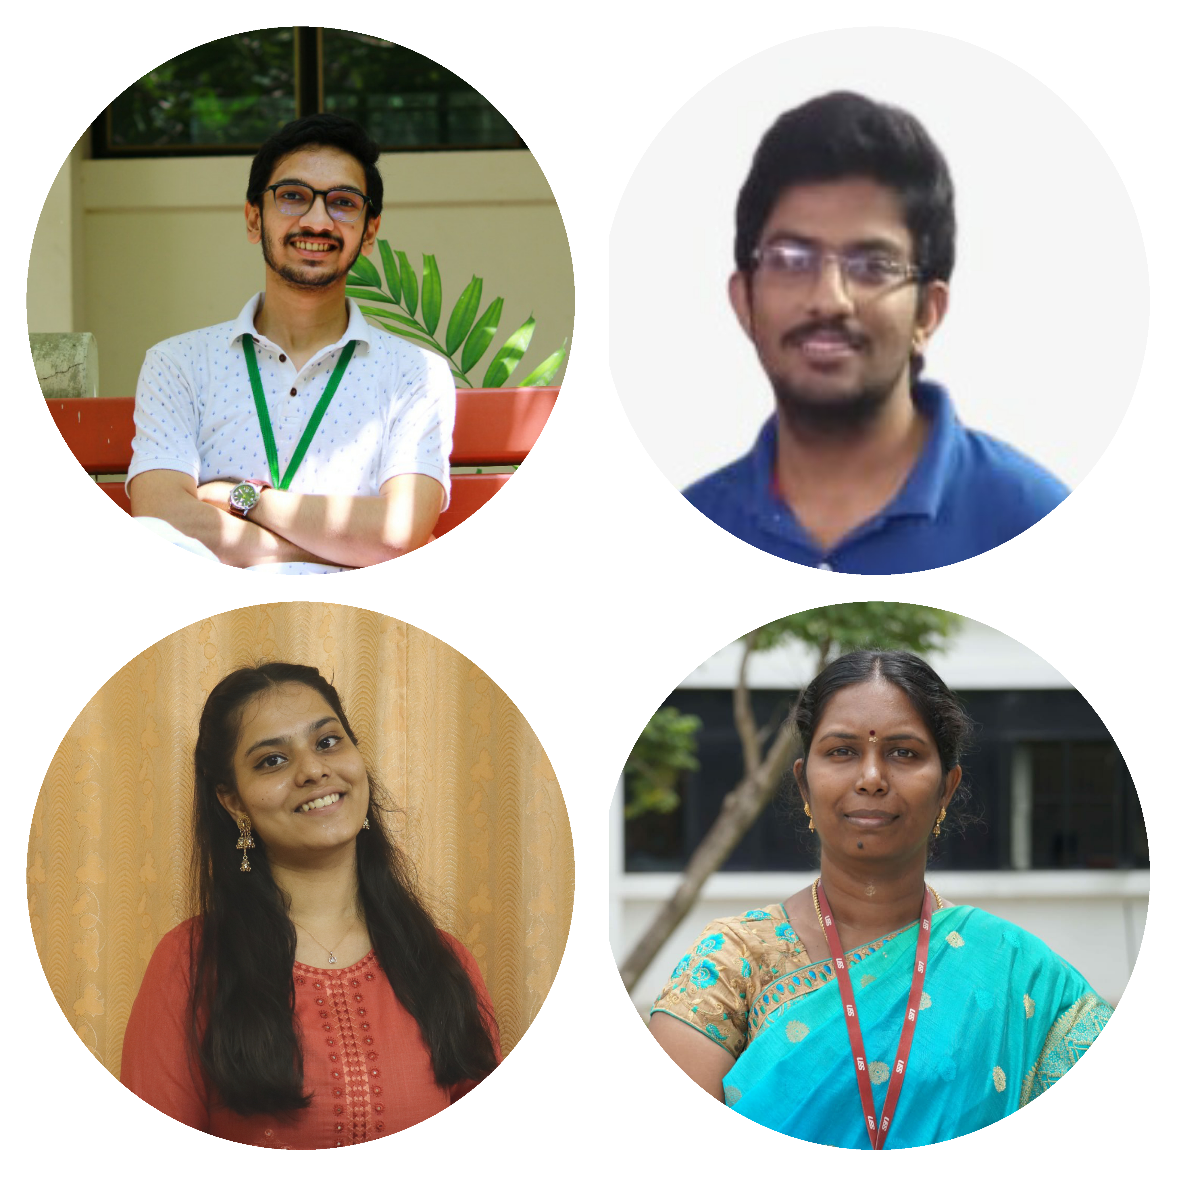
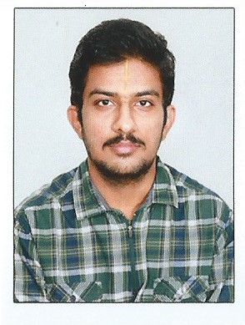
MEET THE TEAM TEAM NAME: PARADOX OF YOUTH FROM SSN COLLEGE OF ENGINEERING, CHENNAI
Saikrishna S Undergraduate, EEE
Backend, ML
V.Harini Undergraduate, EEE
Frontend
Rengarajan S Undergraduate, EEE
Backend, ML

Slide 3
970,000,000
Whoa! That’s a big number!

Slide 4
Defining Mental Health
The WHO states: “Health is a state of complete physical, mental and social well-being and not merely the absence of disease or infirmity.”
An important implication of this definition is that mental health is more than just the absence of mental disorders or disabilities.
Celebrities from sports, management, leadership and various other walks of life, have raised their concerns regarding the importance of mental health.

Slide 5
13% of the world suffers from mental health conditions
In 2017,President announced India is facing “Mental Health Pandemic”
Current Scenario
In 2020,56 million suffer from depression and 38 million from anxiety
14% of Indian Population from Poor Mental health in 2020

Slide 6
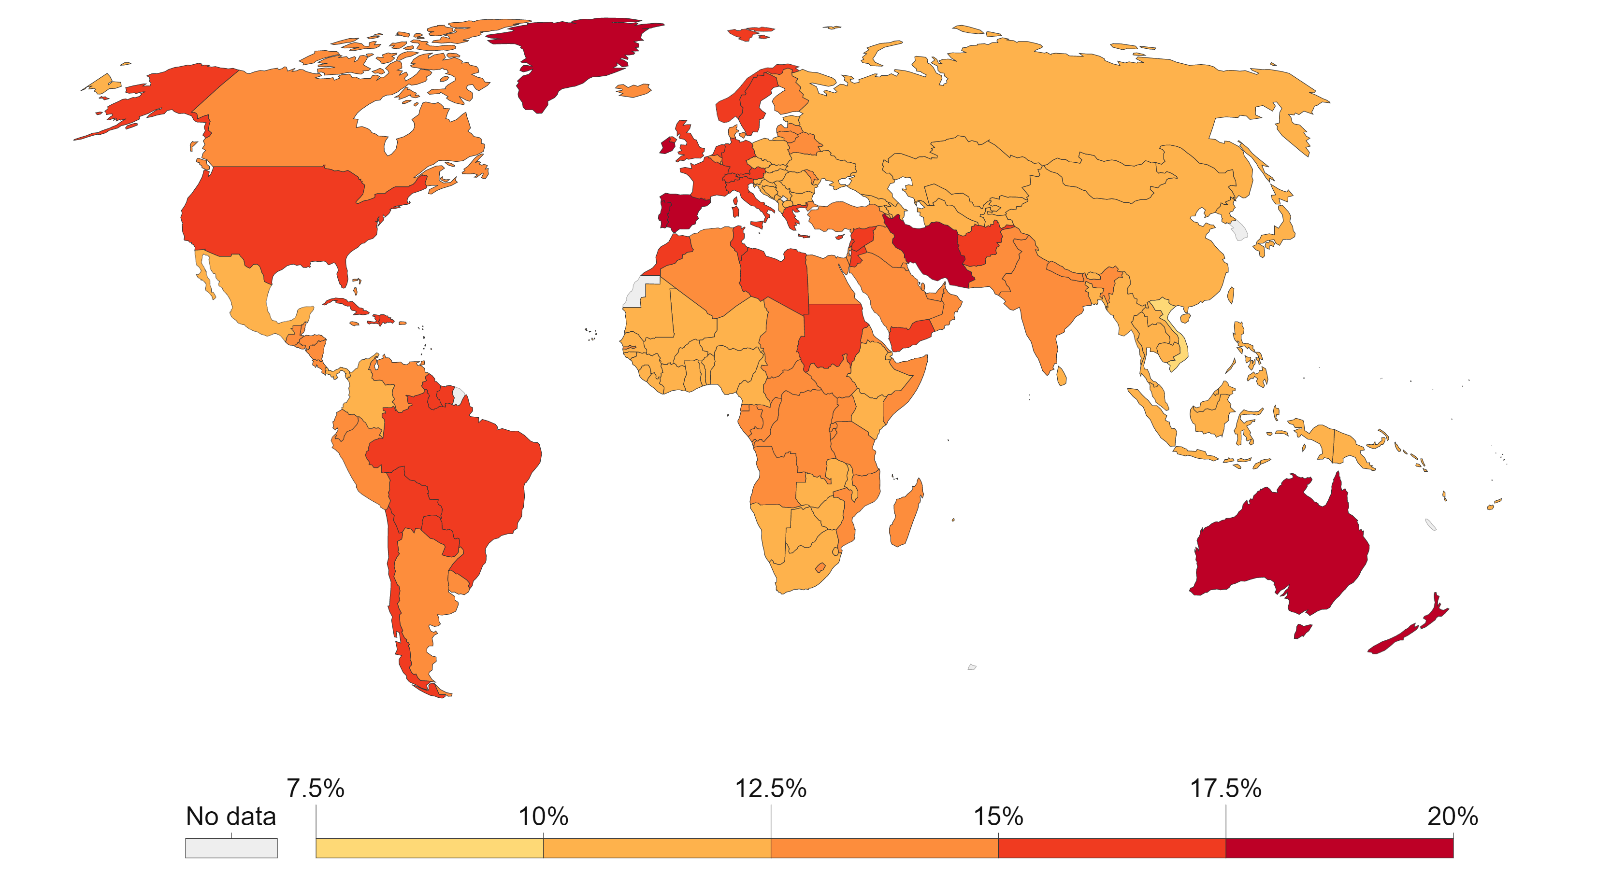
Mental Health Throughout the globe in 2019

Slide 7
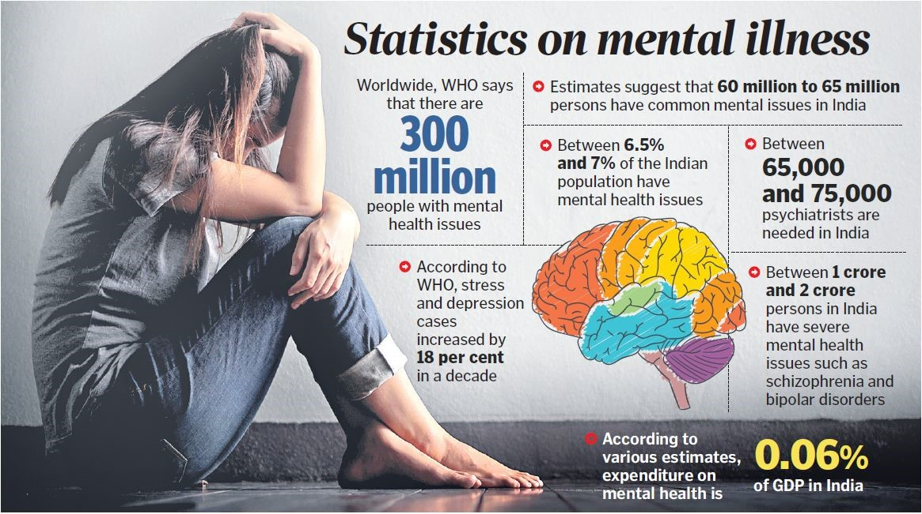

Slide 8
The Proposed Solution
Our own Mental Health Monitor is right at your service…

Slide 9
You spend most of your life inside your head…Make it a nice place to be.

Slide 10
Mental Health Matters.
Our objective is to design a personal assistant that monitors mental wellness.

Slide 11
The Mantra of Solving Mental Health
Prediction
Based on the feedback from the user the website gives suggestions based on the state of mind you are in which is accurate and precise.
Suggestion
Gives suggestions to improve the state of mind, giving the necessary remedies one needs to follow.

Slide 12
Transfer of data from the website to the ML model and displaying the output in the website.
Tech Stack Challenges
Improving the accuracy of the model to make correct predictions.
Integration of ML model with the website.

Slide 13
Working of the Software
01
Predict the Output using Machine Learning Model
Get the data from the user
Mental Health Prediction
03
02
Compare the data

Slide 14
Salient Features
AWARENESS
DISCOVERY
ACCURACY
PRECISION
HAPPINESS
EVALUATION

Slide 15

DESIGNED WEBSITE

Slide 16
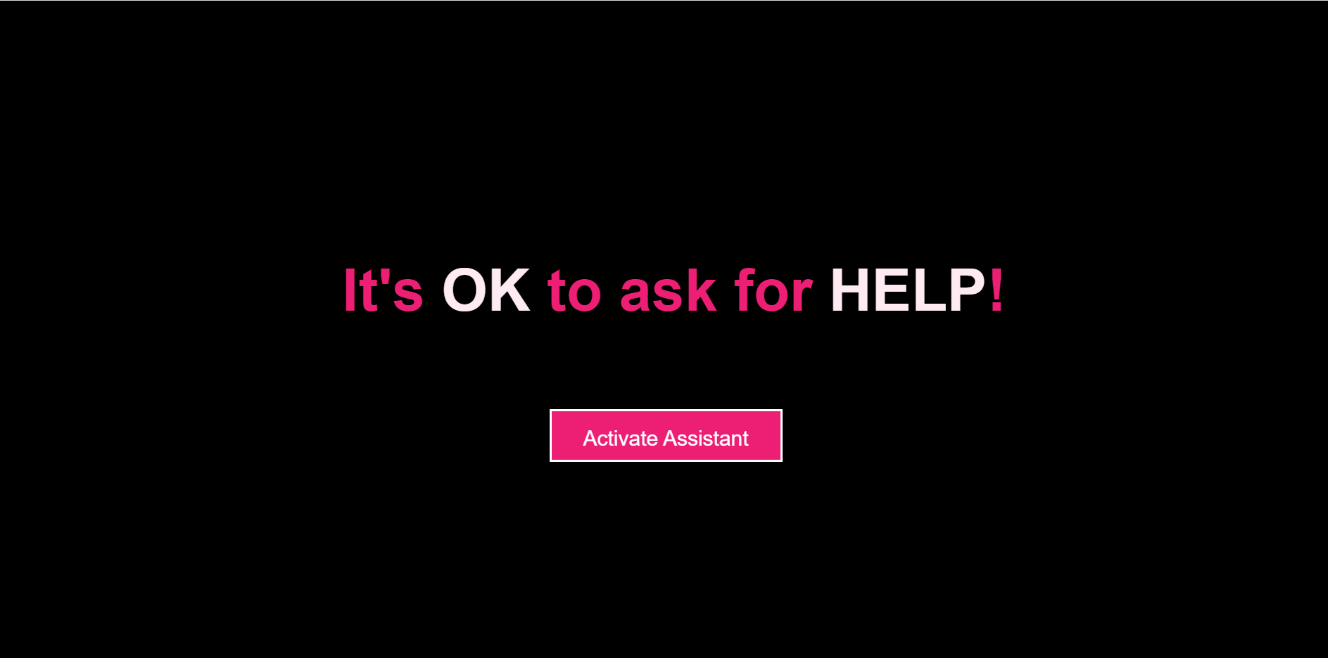
DESIGNED WEBSITE

Slide 17
Future Scope
Providing Seminars,
Conferences in the platform so that the awareness of mental health becomes Global.
Constantly increasing the accuracy and taking the app to a global level.
Integrating it with Time management system can help us maintain our schedule.
Integrating the website into an App.

Slide 18
Thank You!!

